Slide 1
Introduction to python 01
COTM5284

Slide 2
Install python IDLE and Pycharm
Text editors:
Are environments where we edit our code.
Examples of text editors are: note pad, visual studio code, python IDLE , pycharm, etc.
For this part of the course we use the python IDLE and pycharm to edit our python codes.

Slide 3
Install python IDLE and Pycharm
Download the software from these links and install them on your computer:
Python: https://www.python.org/downloads/
PyCharm: https://www.jetbrains.com/pycharm/download/#section=windows
While installing PyCharm make sure pip is activated.
PiPy: https://pypi.org/
Additional:
https://cloud.google.com/python/docs
https://www.gurobi.com/documentation/9.0/quickstart_mac/py_python_interface.html

Slide 4
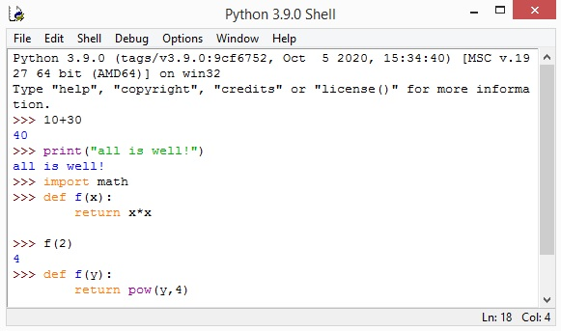
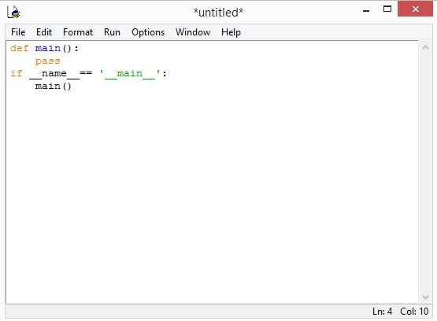
Interface (IDLE)
Figure 1: The python shell / interpreter window | Figure 2: Python code editor window

Slide 5
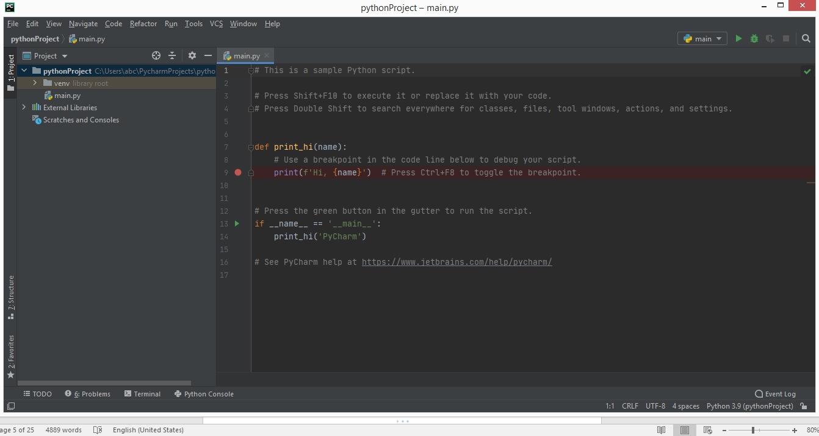
Interface (Pycharm)
Figure 3: PyCharm interface in Darcula Appearance (Theme)

Slide 6
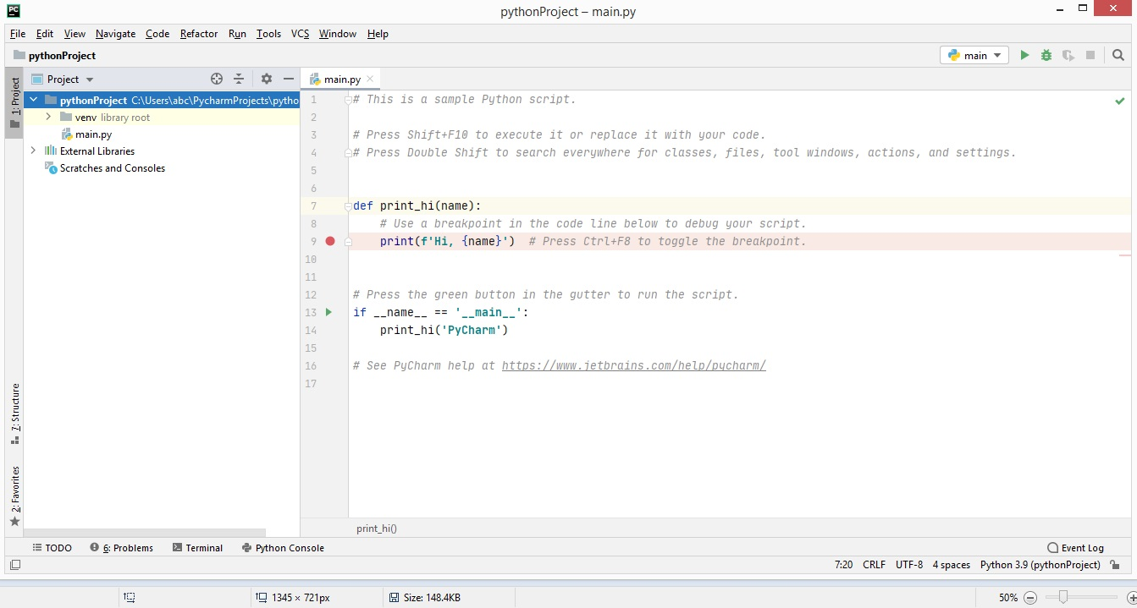
Interface (Pycharm)
Figure 4: PyPharm interfce in IntelliJ Light appearance (Theme)

Slide 7
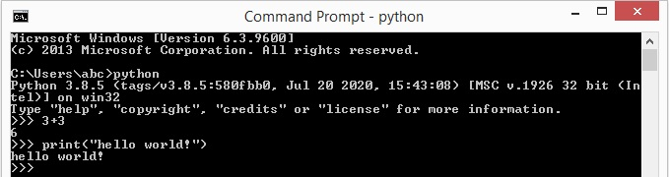
Command prompt
My computer + right click in the window + advanced system setting + environment variables + double click on path (under system variables) + add the paths:
(C:\Users\UserName\AppData\Local\Programs\Python\Python38-32)
(C:\Users\UserName\AppData\Local\Programs\Python\Python38-32\Scripts)

Slide 8
Help in python
help()
help> set Squeezed text (164 lines.) (double click and find more information) help> | help> list Squeezed text (137 lines.) (double click and find more information) | help> float Squeezed text (200 lines.) (double click and find more information)
Variables

Slide 9
Variables
Variables are memory locations to store values.
name="abebe" (string)
abebe=25 (number value)
abebe,kebede,mola=25,24,42 ( multiple assignment)
abebe=kebede=mola=25
name,age="abebe",25
name, age="Abebe",25
type(age)
<class 'int'>
type(name)
<class 'str'>
id(name)
2194224076976
id(age)
2194165361712

Slide 10
Data types :
Numeric (int, float, complex, bool )
Sequence (String, List, Tuple, Set, range )
Dictionary (Map)

Slide 11
Data types :
Numeric (int, float, complex, bool )
a=10
b=10.5
c=5j+3
d=True
type(a)
<class 'int'>
type(b)
<class 'float'>
type(c)
<class 'complex'>
type(d)
<class 'bool'>

Slide 12
Data types :
Sequence (String, List, Tuple, Set )
String means text.
List is a comma separated value that allows us to access any item based on its index.
Tuple is similar to list except that in list we can change values while in tuple we cannot change values of elements. Meaning, list is mutable where tuple is immutable.
A comma separated values that are marked with curly bracket are called set.

Slide 13
Data types :
Sequence (String, List, Tuple, Set )
s='Abebe'
t="All is well“
l=[10,20,30]
m=['Abebe', 'Kebede', 'Selam']
Index | 0 | 1 | 2 | 3 | 4
 | A | b | e | b | e
index | -5 | -4 | -3 | -2 | -1
Index | 0 | 1 | 2
 | 10 | 20 | 30
index | -3 | -2 | -1

Slide 14
Data types :
Sequence (String, List, Tuple, Set )
t=("Abebe","Kebede","Selam")
t=(5,6,7)
l={10,20,30}
m={'Abebe', 'Kebede', 'Selam‘}

Slide 15
Data types :
Dictionary (Map)
Every dictionary has a key and value. Key value pair. You cannot have two similar keys.
Len, update a dictionary, del function, …
d={"Abebe":10,"Kebede":9, "Selam":8}

Slide 16
Sequence (String, List, Tuple, Set)
Practice the following in Python’s IDLE, pycharm’s console or CMD
Data types :
t="All is well "
u="With the world"
t+u
'All is well With the world'
t*2
'All is well All is well '
t[6]
' '
t[10]
'l'
t[-3]
'l'
len(t)
12
t.capitalize()
'All is well '
t.upper()
'ALL IS WELL '
t.lower()
'all is well ‘
t.join("123 ")
'1All is well 2All is well 3All is well '
u="%s and %s are %d"
u%("Abebe","Kebede",25)
'Abebe and Kebede are 25'
print('it\'s all "well"')
it's all "well"

Slide 17
Sequence (String, List, Tuple, Set)
Practice the following in Python’s IDLE, pycharm’s console or CMD
Data types :
Print the following text all in one line in your IDL environment ( take note the fact that ‘\n’ is printed as new line in python.\\n is printed as \n. Also take note of the fact that putting ‘r’ in front of any string allows you to print it as it is without further consideration of syntax.):
Sara’s file is located in the computer’s hard disk, C:\new-folder1\new-folder2.
Answer:
>>> print("Sara's file is located in the computer's hard disk, C:\\new-folder1\\new-folder2.")
Sara's file is located in the computer's hard disk, C:\new-folder1\new-folder2.
>>> print(r"Sara's file is located in the computer's hard disk, C:\new-folder1\new-folder2.")
Sara's file is located in the computer's hard disk, C:\new-folder1\new-folder2.

Slide 18
Sequence (String, List, Tuple, Set)
Practice the following in Python’s IDLE, pycharm’s console or CMD
Data types :
l=[10,20,30]
m=["Abebe","Kebede","Selam"]
l+m
[10, 20, 30, 'Abebe', 'Kebede', 'Selam']
len(l)
3
l*2
[10, 20, 30, 10, 20, 30]
l.append("Mola")
l
[10, 20, 30, 'Mola']
l.count(20)
1
l.extend([1,2,3])
l
[10, 20, 30, 'Mola', 1, 2, 3]
l[0:5]
[10, 20, 30, 'Mola', 1]
l[:5]
[10, 20, 30, 'Mola', 1]
l[0:]
[10, 20, 30, 'Mola', 1, 2, 3]
min(l)
10
max(l)
30
l.remove(30)
l
[10, 20]
l.pop(0)
10

Slide 19
Sequence (String, List, Tuple, Set)
Practice the following in Python’s IDLE, pycharm’s console or CMD
Data types :
t=(10,20,30)
u=("Abebe","Kebede","Selam")
t+u
(10, 20, 30, 'Abebe', 'Kebede', 'Selam')
t*2
(10, 20, 30, 10, 20, 30)
len(t)
3
t.count(10)
1
t.index(30)
2
min(t)
10
max(t)
30
t[0]
10
t[0:3]
(10, 20, 30)

Slide 20
Sequence (String, List, Tuple, Set)
Practice the following in Python’s IDLE, pycharm’s console or CMD
Data types :
s={10,20,30,40}
t={"Abebe", "Kebede", "Selam"}
u={"a","b","c"}
len(s)
4
t.remove("Selam")
t
{'Abebe', 'Kebede'}
t.add(10)
t
{10, 'Abebe', 'Kebede'}
s.union(t.union(u))
{'Abebe', 40, 'b', 10, 20, 'Kebede', 'c', 'a', 30}
s.intersection(t)
{10}
s.intersection(t.intersection(u))
set()

Slide 21
Operators
[ Arithmetic operators -Parenthesis ( () ), multiplicative (*, /, //, %), additive (+, -)]
[Assignment operators ( = , += , -= , *=, /=, %= )]
[Relational operators - ( < , > , <= , >= , == , != )]
[Logical operators - logical AND ( and ), logical OR ( or )]
[Postfix and Unary operators (--, ++, not)]

Slide 22
Operators
[ Arithmetic operators -Parenthesis ( () ), multiplicative (*, **,/, //, %), additive (+, -) ]
+,-,*,/,//,% can be applied on integers, floats, etc.
+ and * can also be applied on strings (concatenation), lists and tuples
4/2*3+4
10.0
4/2*(3+4)
14.0
4%2
0
3%2
1
4//2
2
3//2
1
10**2
100
10**3
1000

Slide 23
Operators
[Assignment operators ( = , += , -= , *=, /=, %= )]
x=3
x
3
x+=3
x
6
y=3
y-=3
y
0
z=3
z*=3
z
9
x=4
x/=4
x
1.0
y=3
y%=3
y
0

Slide 24
Operators
[Relational operators - ( < , > , <= , >= , == , != )]
x=3
y=4
x<y
True
x>y
False
x<=y
True
x>=y
False
x=10
y=20
x==y
False
x!=y
True

Slide 25
Operators
[Logical operators - logical AND ( and ), logical OR ( or )]
x>y or x<y
True
x==y or x != y
True
x>y and X<y
False
x==y and x != y
False
x=0
y=1
x and y
0
x or y
1
x=0
y=0
x and y
0
x or y
0
x=1
y=1
x and y
1
x or y
1
x=1
y=0
x and y
0
x or y
1

Slide 26
Operators
[Postfix and Unary operators (--, ++, not)]
x=10
--x
10
-x
-10
++x
10
+x
10
x=10
not x
False

Slide 27
Operators
class exercises
Exercise: 01
Make use of your IDLE environment and compute the following problem.
Y=a(r+1)^{t}
The above formula is to a value that exponential growth over time. ‘Y’ value after ‘t’ period of time, ‘t’ is the total period of time. ‘a’ is initial value , ‘r’ is rate at which a value increases during the period ‘t’. If initial salary of a person is 5000 birr and increases by 6% every year, what is the value of Y in 10years?
Answer:
>>> 5000*((6/100)+1)**10
8954.238482714272
Exercise: 02
Rearrange the following operations in their hierarchical order first to last (division, multiplication, subtraction, exponents, and addition).
Answer:
Exponents, division, multiplication, subtraction and addition.
Exercise: 03
There are operators for arithmetic, relational, logical and bitwise operations. Try to Rearrange the following operators in their hierarchical order first to last, based on your past experience.
logical OR ( || ) or (or), multiplicative ( *, / ,% ) , postfix and unary (++ , -- , !) , logical AND ( && ) or (and), Parenthesis ( () ) , additive ( + , - ) , assignment ( = , += , -=, *=, /=, %= ) , relational ( < >, <= ,>= ), equality ( == != )
Answer:
Parenthesis ( () ), postfix and unary (++, -- , not) , multiplicative ( * / // % ), additive ( + - ), relational ( <, > ,<=, >= ), equality ( == , != ) , logical AND ( && ) or (and) , logical OR ( || ) or (or), assignment ( =, +=, -=, *=, /=, %= )

